Slide 1
Testing Probiotics to Reduce Nitrogen Fertilizer and Water Usage in Turfgrasses: Project Funded by OTRF
Manish N. Raizada
Professor
University of Guelph

Slide 2
Challenges and opportunities
>The world is projected to consume $127 billion USD of synthetic nitrogen fertilizer by 2022.
>Climate change may worsen periods of drought.
>Growing demands to reduce the negative impacts of turf.
>Similar to the human gut, plants are inhabited by microbes.
>’Inoculants' or ‘biologicals’ are probiotic microbes that can be coated onto seeds or sprayed onto plants, to reduce the need for fertilizers and irrigation.
>The global ‘biofertilizer’ market is growing exponentially, from $1.4 billion in 2016 to ~$4 billion projected by 2023.

Slide 3
Challenges and opportunities
>The world is projected to consume $127 billion USD of synthetic nitrogen fertilizer by 2022.
>Climate change may worsen periods of drought.
>Growing demands to reduce the negative impacts of turf.
>Similar to the human gut, plants are inhabited by microbes.
>’Inoculants' or ‘biologicals’ are probiotic microbes that can be coated onto seeds or sprayed onto plants, to reduce the need for fertilizers and irrigation.
>The global ‘biofertilizer’ market is growing exponentially, from $1.4 billion in 2016 to ~$4 billion projected by 2023.

Slide 4
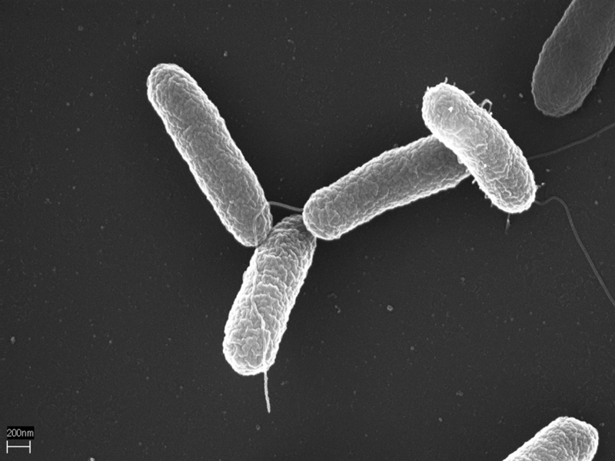
Challenges and opportunities
>The world is projected to consume $127 billion USD of synthetic nitrogen fertilizer by 2022.
>Climate change may worsen periods of drought.
>Growing demands to reduce the negative impacts of turf.
>Similar to the human gut, plants are inhabited by microbes.
>’Inoculants' or ‘biologicals’ are probiotic microbes that can be coated onto seeds or sprayed onto plants, to reduce the need for fertilizers and irrigation.
>The global ‘biofertilizer’ market is growing exponentially, from $1.4 billion in 2016 to ~$4 billion projected by 2023.
RH=root hair
Green=probiotic cells

Slide 5
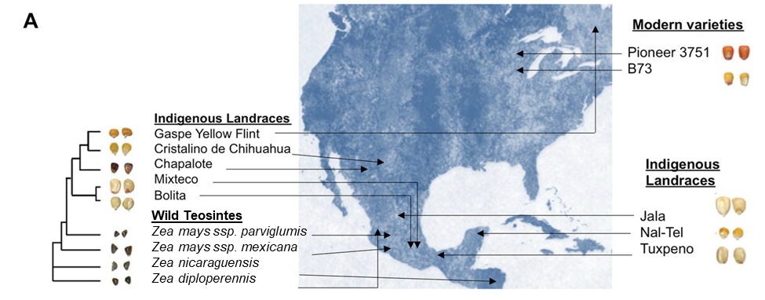
Research Background
>corn is a relative of turfgrasses and microbes are transferable
>25-50% of corn probiotics (endophytes) from ancient Mexico/Central America lost during breeding but still exist in wild relatives & traditional landraces.
>Following 10 years of research, we have discovered 14 probiotics that boost nitrogen use efficiency (NUE) and/or stimulate root growth for better water uptake in annual ryegrass.
>Probiotics may improve crop NUE and reduce N fertilizer demands by at least 3 potential mechanisms:
1.Convert atmospheric N₂ gas into ammonia fertilizer (biological N fixation);
2. Stimulate root growth;
3. Recycle internal reserves of organic N from senescing tissues, for export to growing tissues.
Sources
Culturing

Slide 6
Research Background
>corn is a relative of turfgrasses and microbes are transferable
>25-50% of corn probiotics (endophytes) from ancient Mexico/Central America lost during breeding but still exist in wild relatives & traditional landraces.
>Following 10 years of research, we have discovered 14 probiotics that boost nitrogen use efficiency (NUE) and/or stimulate root growth for better water uptake in annual ryegrass.
>Probiotics may improve crop NUE and reduce N fertilizer demands by at least 3 potential mechanisms:
1.Convert atmospheric N₂ gas into ammonia fertilizer (biological N fixation);
2. Stimulate root growth;
3. Recycle internal reserves of organic N from senescing tissues, for export to growing tissues.
Sources
Culturing

Slide 7
Research Background
>corn is a relative of turfgrasses and microbes are transferable
>25-50% of corn probiotics (endophytes) from ancient Mexico/Central America lost during breeding but still exist in wild relatives & traditional landraces.
>Following 10 years of research, we have discovered 14 probiotics that boost nitrogen use efficiency (NUE) and/or stimulate root growth for better water uptake in annual ryegrass.
>Probiotics may improve crop NUE and reduce N fertilizer demands by at least 3 potential mechanisms:
1.Convert atmospheric N₂ gas into ammonia fertilizer (biological N fixation);
2. Stimulate root growth;
3. Recycle internal reserves of organic N from senescing tissues, for export to growing tissues.
Sources
Culturing

Slide 8
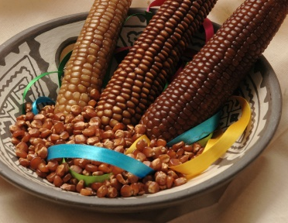
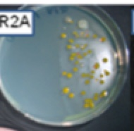
Research Pipeline (2008-2020)
>Step 1. Selected and grew wild relatives and ancient farmer landraces of corn (Zea family) reported to grow in low N soils, including many under dry conditions.
>Step 2. Cultured microbes from these plants on N-free media
>Step 3. Screened microbes for nitrogen fixation activity.
Culturing
Gln export

Slide 9
Research Pipeline (2008-2020)
>Step 1. Selected and grew wild relatives and ancient farmer landraces of corn (Zea family) reported to grow in low N soils, including many under dry conditions.
>Step 2. Cultured microbes from these plants on N-free media
>Step 3. Screened microbes for nitrogen fixation activity.
>Step 4. Tested hundreds of microbes for their ability to promote shoot and root growth of annual ryegrass in the absence of N fertilizer in test tubes (14 promising strains identified that improve root biomass by 30-80% in 3 trials)
Culturing
Gln export
Annual ryegrass
NUE trial

Slide 10
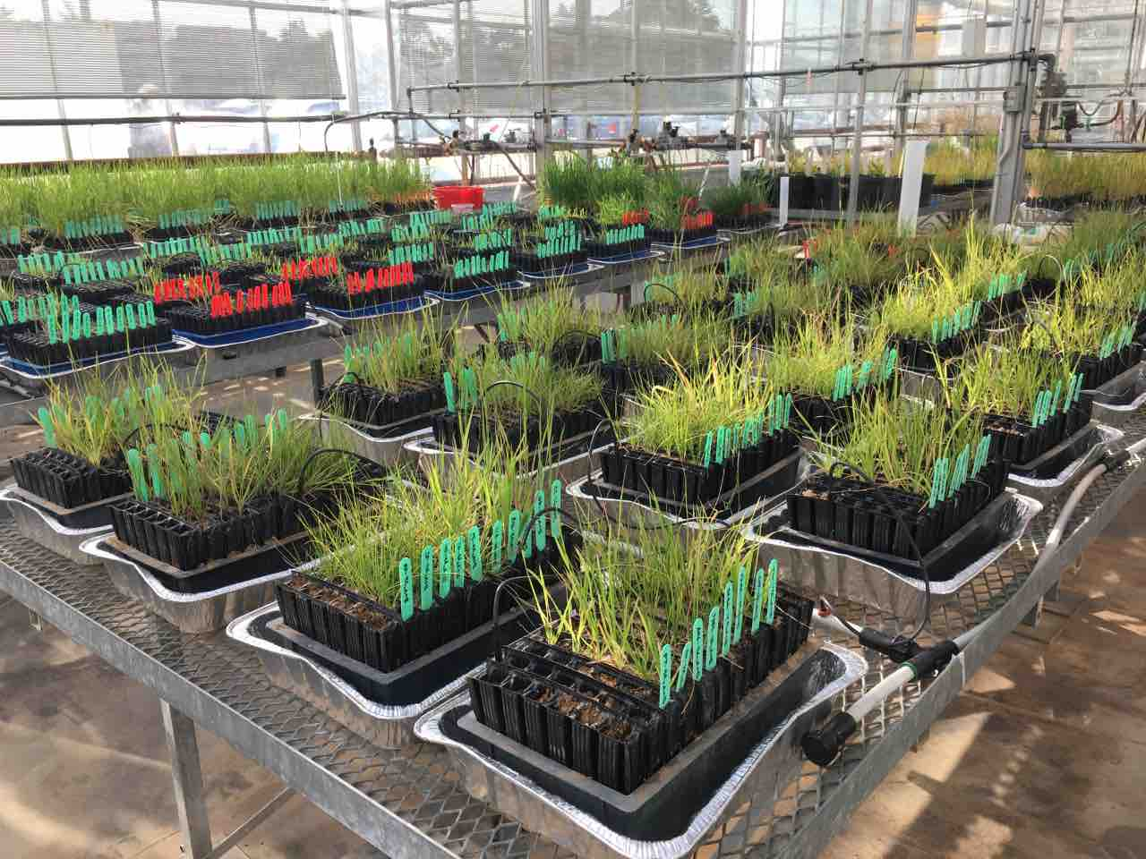
Research Pipeline (2008-2020)
>Step 5. Test 14 best probiotic strains with diverse
turfgrass and forage grass varieties indoors to find most
compatible host genotypes (ongoing 2018-2019):
.

Slide 11
--Annual ryegrass - Lolium multiflorum
--Rough bluegrass – Poa trivialis
--Jackrabbit Kentucky Bluegrass – Poa pratensis Jackrabbit
--Kentucky bluegrass – Poa pratensis
--Canada bluegrass – Poa compressa
--Timothy – Phleum pratense – Climax
--Perennial ryegrass – Lolium perenne – Fiesta 4
--Chewings fescue – Festuca rubra var commutate
--Sheep fescue – Festuca ovina – Quatro
--Hard fescue – Festuca longifolia
--Tall fescue – Lolium arundinacea Carnival
--Orchardgrass – Dactylis glomerata Echelon
--Smooth bromegrass – Bromus inermis Coated Radisson
--Creeping bentgrass – Agrostis stolonifera Penn A4
--Common Creeping bentgrass – Agrostis stolonifera
--Redtop bentgrass– Agrostis gigantean
--Western wheatgrass – Pascopyrum smithii
--Creeping Red fescue – Festuca rubra
.

Slide 12
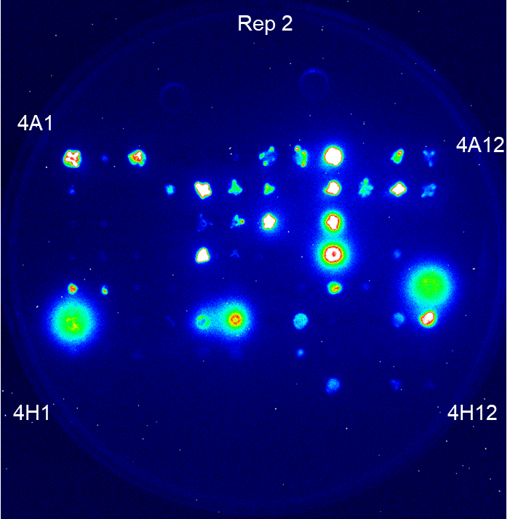
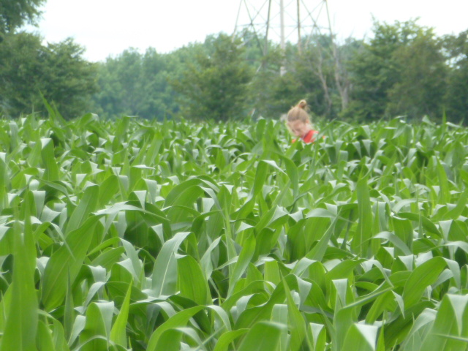
Research Pipeline (2008-2020)
>Step 5. Test 14 best probiotic strains with diverse
turfgrass varieties indoors to find most
compatible host genotypes (ongoing 2018-2020)
>Step 6. FUTURE: With the best microbes, use laboratory
directed evolution to evolve improved turf colonization and
improved nitrogen/drought activities.
>Step 7. FUTURE: Conduct turf field trials using best microbes
and most compatible hosts, along with further bacterial evolution.
Nitrogen export

Slide 13
Project Deliverables
Safe seed/soil inoculant that:
1. Reduces turf demand for inorganic nitrogen fertilizer under field conditions.
2. Improves root growth to improve water uptake
And ability to withstand dry periods.
3.Creates additional multi-function benefits (e.g. disease resistance) that may boost overall health.

Slide 14
Acknowledgements
Funding
Ontario Turfgrass Research Foundation
Quebec Turfgrass Research Foundation
NSERC Ideas to Innovation (I2I)
Previous and Current Personnel
Dr. Travis Goron – post-doctoral fellow
Dr. Malinda Thilakarathna – post-doctoral fellow
Hanan Shehata – PhD student
David Johnston-Monje – PhD student
Anuja Shrestha – technician
Chris Dumigan – MSc student
Special Thanks
Prof. Eric Lyons (U.Guelph)
Debbie Conrad (OTRF)
Gavin Carnegie (PickSeeds)
GTI
QTRF

